Slide 1
Ralayala seema university kurnool sri sankars degree college in kurnool
m greswari
Bsc micro biology
21367008007

Slide 2
Projcet title:understanding nessus threat exploring and INFORMATION
Team ID : LTVIP2024TMID14115
Team Size :5
Team Leader : Repakula Somanath
Team member : Maddela Jeevan Kumar
Team member : Masapogu Greswari
Team member : S Anwar Basha
Team member : Syed Ashafaq Ali
college: sri sankars degree college kurnool

Slide 3
index
sno Topic name
Introduction for cyber threat and vulnerabilitie scaning
Dns information gathring to ibomma website
Planing preparation
Basic scaning beyond overview for nessus scaning tools
Basic scaning for report my ip address
Vulnerabilites host service basic scaning
Host discovery for ip address
Report analysis for nessus scaning Vulnerabilities for report scaning nessus my ip address
Scanner Web app scaning for my ip source
Vulnerabilities for resource commonly webapp
Dns lookup gathering my ip address
Commonly my ip address
Nessus scaning key ponits
Nessus scaning domain ip complete submit for ibomma report dns information
Page number
5
6
7
8
9
10
11
12
13
14
15-17
18
19
20

Slide 4
Understanding for threat for exploring and nessus information report
And nessus vulnerabilities

Slide 5
Introduction for cyber threat AND VULNERABLILTIE SCANNING
Understanding a Nessus report is a key aspect of cybersecurity, especially in threat analysis and mitigation. Nessus is a widely used vulnerability assessment tool that scans systems and networks for potential vulnerabilities and generates detailed reports. Here's a basic introduction to cyber security for threat understanding using Nessus reports:
Understanding Vulnerabilities: A vulnerability is a weakness or flaw in a system that can be exploited by attackers to compromise the security of the system. Nessus scans identify these vulnerabilities by probing various aspects of the system, such as open ports, software versions, configurations, etc.
Interpreting Nessus Reports: Nessus generates reports that detail the vulnerabilities found during the scan. These reports typically include information such as the severity of the vulnerability, affected systems, description of the vulnerability, and potential impact if exploited.
Severity Levels: Vulnerabilities are often categorized into severity levels such as critical, high, medium, and low. Critical vulnerabilities pose the most significant risk and should be addressed immediately, while low-severity vulnerabilities may not pose an immediate threat but should still be remediated to reduce overall risk.

Slide 6
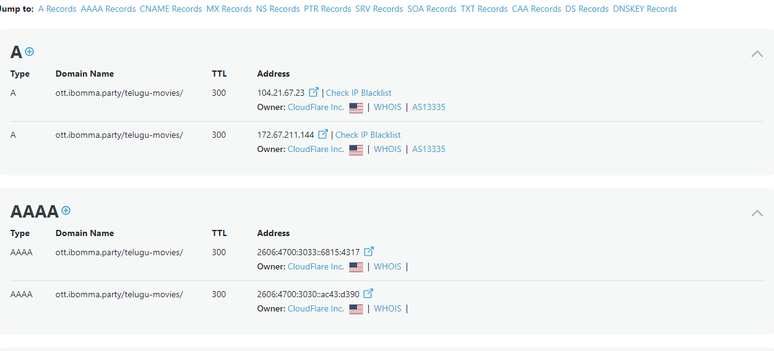
Dns information gathering to target:ibomma website

Slide 7
Planing for preparation
Nessus Vulnerability Assessment Project Plan
1. Project Initiation
Objective Definition: Clearly define the objectives of the Nessus vulnerability assessment project. Example: "To identify and remediate vulnerabilities in the organization's internal network infrastructure to improve overall security posture."
Scope Identification: Define the scope of the project, including the systems, networks, and assets to be assessed. Example: "The assessment will cover all servers, workstations, and networking devices within the internal network.“
2.Resource Allocation
Team Formation: Identify the project team members responsible for conducting the Nessus scans, analyzing the results, and implementing remediation actions. Example: Security Analyst, Network Administrator, System Administrator.
Timeframe: Determine the project timeline, including milestones and deadlines for each phase of the assessment. Example: "The project will be completed within four weeks, with Nessus scans conducted in the first two weeks and remediation activities carried out in the subsequent two weeks."

Slide 8
basic scaning beyond over view nessus scanning tools
3.Pre-Scan Preparation
Nessus Installation: Install and configure the Nessus vulnerability scanner according to organizational requirements and best practices.
Scan Policy Configuration: Define and configure scan policies in Nessus based on the project scope and objectives. Customize scan settings to minimize impact on production systems while maximizing vulnerability coverage.
4.Initial Scan
Scan Execution: Perform an initial Nessus scan of the target environment to identify vulnerabilities, misconfigurations, and potential security issues.
Scan Analysis: Analyze the results of the Nessus scan to prioritize vulnerabilities based on severity ratings, potential impact, and exploitability.
5.Remediation Planning
Vulnerability Prioritization: Prioritize vulnerabilities for remediation based on risk factors and organizational priorities. Develop a remediation plan outlining specific actions for addressing each identified vulnerability.

Slide 9
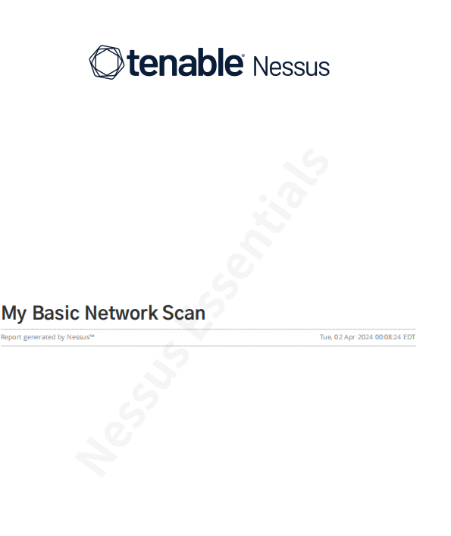
Basic scan for report my ip address

Slide 10
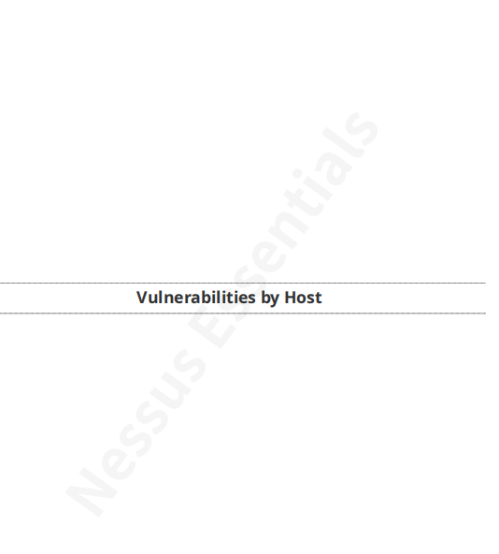
Vulnerabilities to host service for basic scan

Slide 11
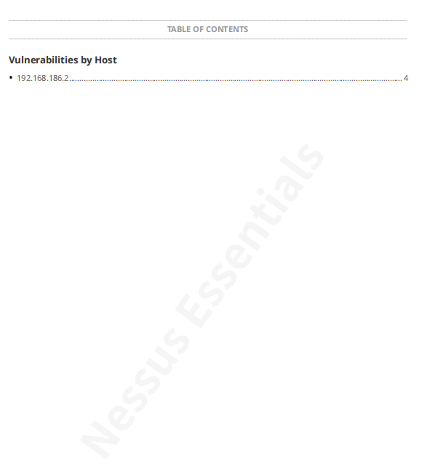
Host discovery for vulnerabilities

Slide 12
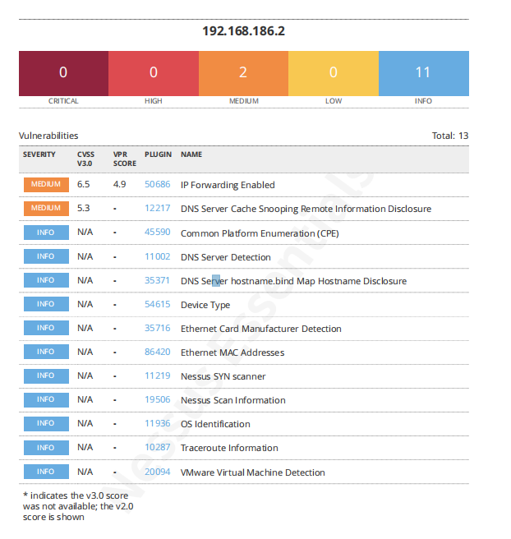
These report for analysis for my ip address

Slide 13
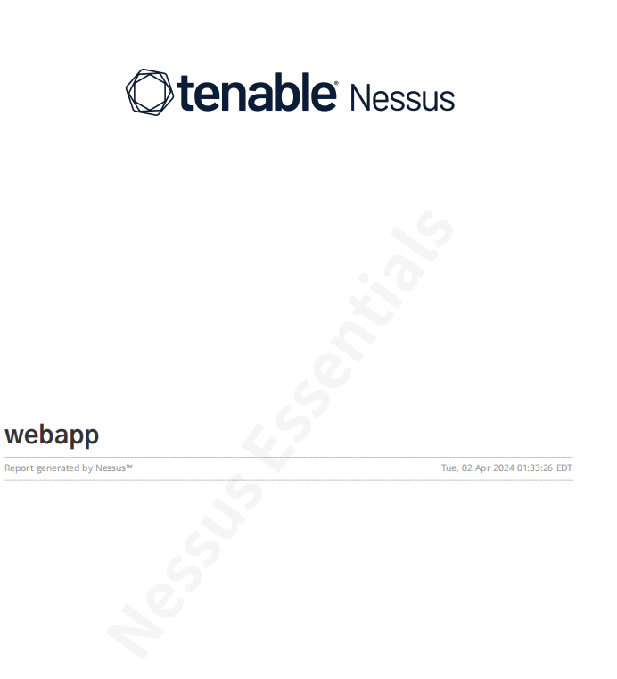
Webapp for my ip address source

Slide 14
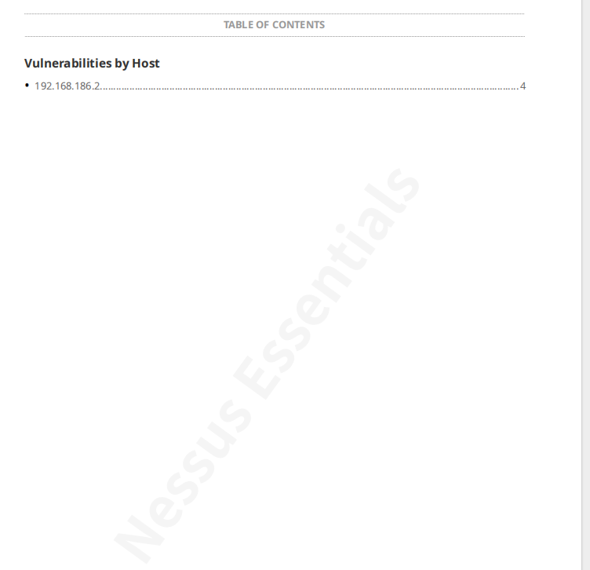
The vulnerabilities for resource commonly scaning

Slide 15
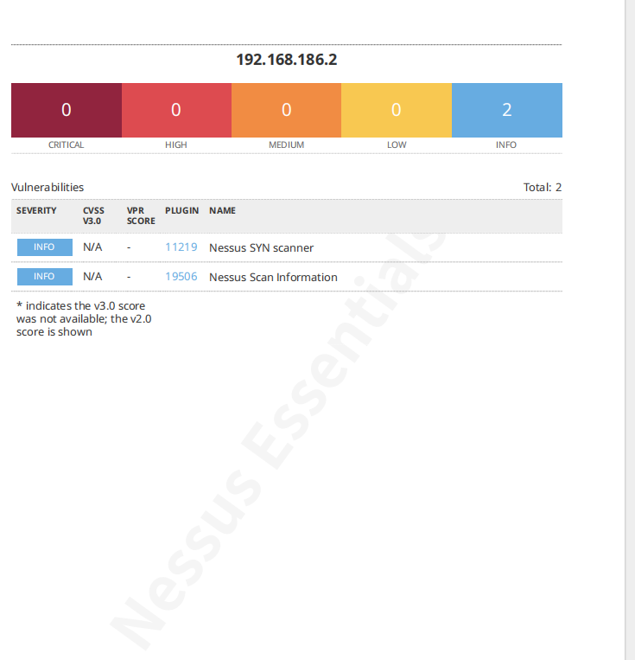
Scaner for web app source

Slide 16
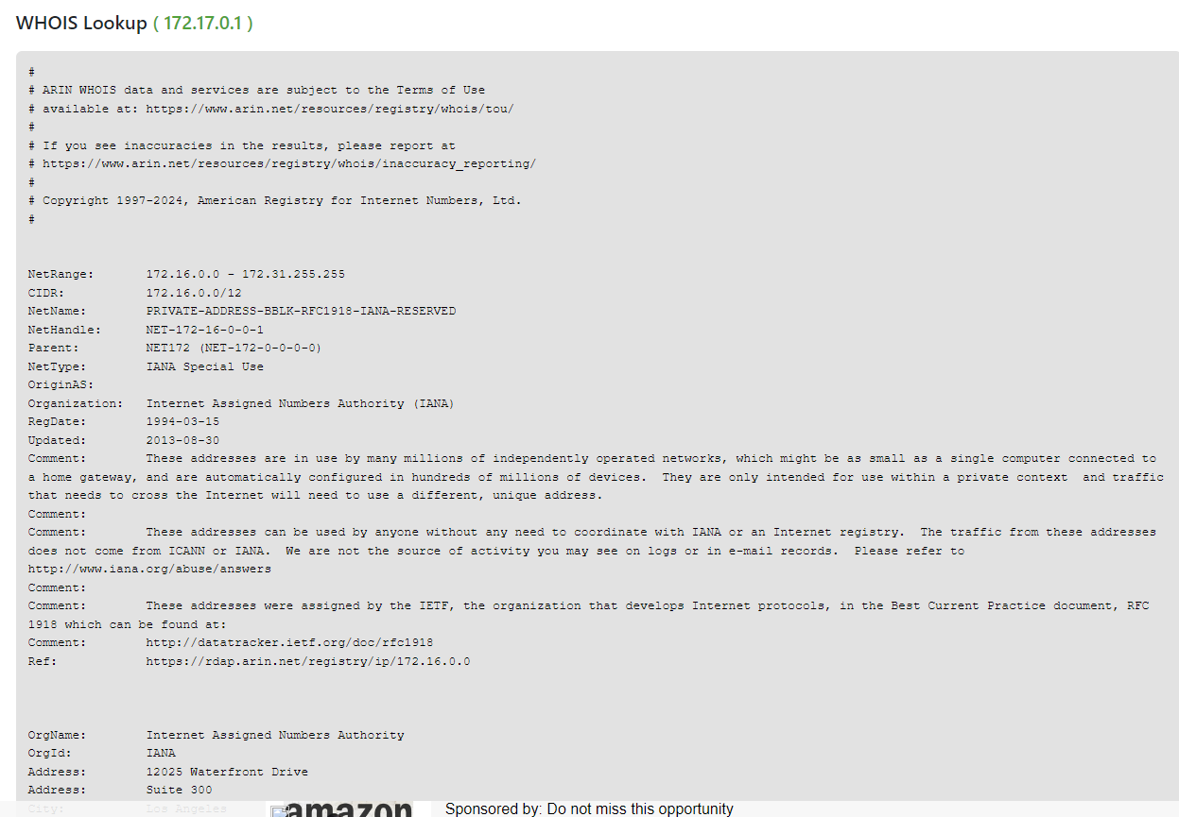
Dns look up information to gathering for source into my ip address

Slide 17
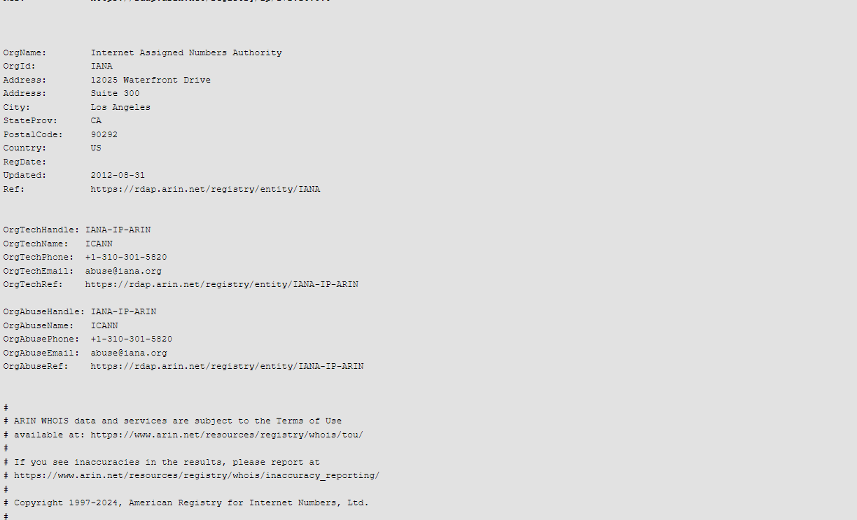
These are more details analysis dns look up or ip address

Slide 18
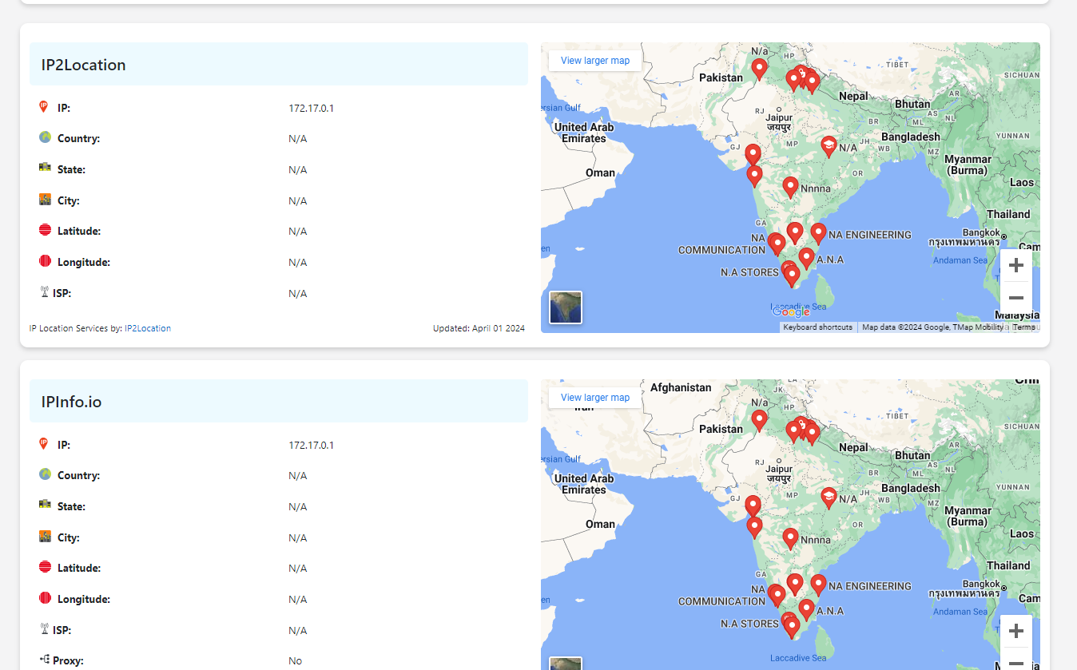
These are common only my ip address

Slide 19
Nessus scanning key points
Vulnerability Detection: Nessus scans networks, systems, and applications to identify vulnerabilities that could be exploited by attackers.
Comprehensive Coverage: It supports various platforms and technologies, including Windows, Linux, Unix, network devices, databases, web servers, and more.
Customizable Scans: Users can configure scans based on their specific requirements, including target selection, scan type (e.g., full, credentialed, web application), and scan frequency.
Reporting: Nessus generates detailed reports outlining discovered vulnerabilities, severity levels, and remediation recommendations. These reports help organizations prioritize and address security issues effectively.
Integration: It can integrate with other security tools and platforms, such as SIEM (Security Information and Event Management) systems and ticketing systems, to streamline vulnerability management processes.

Slide 20
Nessus for domain and report
Nessus is a popular vulnerability scanner used to identify security issues in networks and systems.
Once you've run a scan with Nessus, you can generate a report detailing the vulnerabilities it found, along with recommendations for remediation.
Ibomma report for analysis in their website in complete process submit

